Slide 1
Learning Arrangements with
High External Regulation:
Why Fostering Learners' Self-regulation is of Special Importance
Alexander Renkl
University of Freiburg, Germany

Slide 2
What is Meant by Self-Regulation?
The present focus:
Learning functions are performed by the learners on their own (i.e., student initiated)
Examples:
- Elaboration: Student thinks of an own example
- Metacognition: Student monitors her understanding
- Motivation: Student encourages herself
- Volition: Student shuts down her smartphone

Slide 3
External Regulation, Prompted Self-Regulation, and Self-Regulation
Just for the sake of simplicity:
A continuum divided in 3 sections "Self-Prompted-External"
The case of explaining a worked example
External Regulation | Prompted Self-Regulation | Self-Regulation
Teacher-provided explanation | Teacher prompts student to explain the example | Student "self-explains" the example

Slide 4
Assumed Fit Between Modes of Regulation
 | Degree of External Regulation
Degree of student's self-regulation | Loose | Medium | High
Low |  |  | Congruence
Medium |  | Congruence
High | Congruence
Simplified and slightly modified from Vermunt and Verloop (1999)

Slide 5
Learning is best when …
External regulation
Student's self-regulation
Situation A
Situation B

Slide 6
The Central Claim of This Talk:
Learning is best when …
External regulation
Student's self-regulation
Situation A
Situation B

Slide 7
The Central Claim of This Talk:
Learning is best when …
External regulation
Student's self-regulation
Situation A
Situation B

Slide 8
The Worked-Example Effect
Providing worked examples in mathematics:
Often seen as just the opposite of self-regulated math learning
Worked-Example Effect
Note, however, worked examples used in particular ways
E.g., all (!) students are required to explain the worked examples to themselves

Slide 9
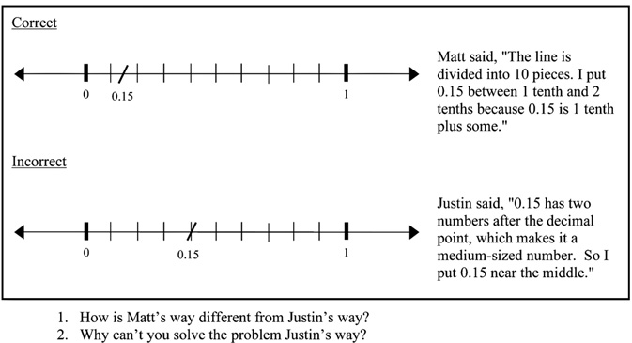
Durkin and Rittle-Johnson (2012)

Slide 10
The Central Claim of This Talk:
Learning is best when …
External regulation
Worked examples
Student's self-regulation
Self-explain
Situation B

Slide 11
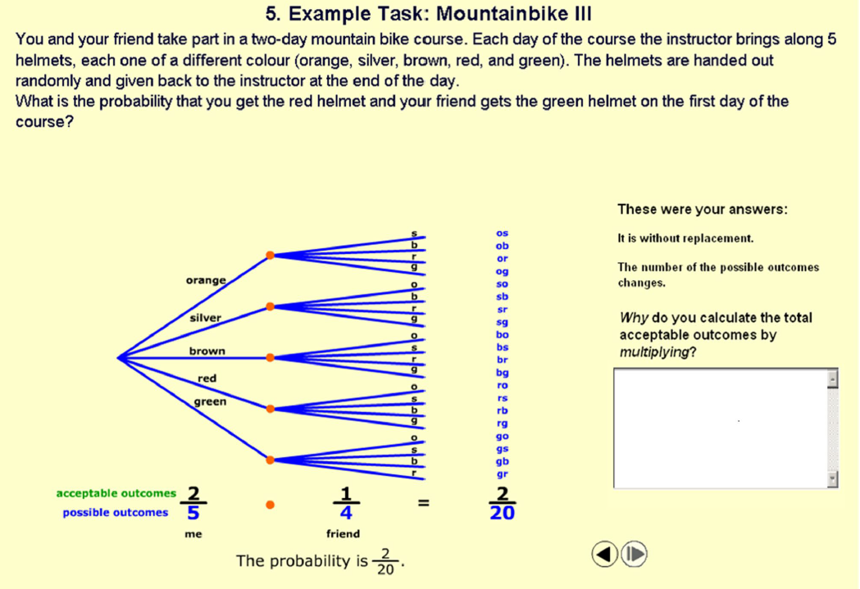
Berthold, Renkl, and colleagues (2009, 2010, etc.)

Slide 12
Berthold, Renkl, and colleagues (2009, 2010, etc.)
Difficult to self-explain!

Slide 13
Two Generally Important Reasons why Substantial Self-Regulation is Always Required
1 The teacher cannot really fulfill the learning function in the individual students' head
External Regulation | Prompted Self-Regulation | Self-regulation
Teacher-provided explanation | Teacher prompts student to explain the example | Student "self-explains" the example
The student has to effectively use what is offered!

Slide 14
Two Generally Important Reasons why Substantial Self-Regulation is Always Required
2 There are too many learning functions to be regulated externally
(this is problem is enforced by student heterogeneity)
Elaboration
Planning
Organisation
Monitoring
Cognitive
Self-explanation
Metacognition
Establishing value
Dealing with anxiety
Keeping up concentration
Dealing with frustration
Motivation &
Volition
Emotion

Slide 15
Two Studies and Their Findings
1 The teacher cannot really fulfill the learning function in the individual students' head
Berthold, K., & Renkl, A. (2010). How to foster active processing of explanations in instructional communication. Educational Psychology Review, 22, 25-40.
2 There are too many learning functions to be regulated externally
Schwonke, R., Ertelt, A., Otieno, C., Renkl, A., Aleven, V., & Salden, R (2013). Metacognitive support promotes an effective use of instructional resources in intelligent tutoring. Learning & Instruction, 23, 136-150.

Slide 16
The Problem Addressed by
Berthold and Renkl (2010)
Sometimes, students are not capable to provide correct self-explanations
Instructional explanations (e.g., by a teacher) have unreliable effect
How to foster the use of instructional explanations?

Slide 17
Prompting by Follow-up Questions and
Active Integrating Demands

Slide 19
Strategic Knowledge
Notes:
Maximalwert: 9 (von 4 VPs erreicht)
Minimum: 0 (5 VPS)
Disordinale Interaktion: in beiden Interaktionsdiagrammen verlaufen die Graphen nicht gleichsinnig
This was a significant interaction effect.
If the learners are not provided with prompts, it doesn’t make a difference, if they integrate the explanation with the solution or not.
However, a request of focused processing in the form of prompts is only helpful, if the learners additionally integrate the explanation with the solution.
Thus, especially a combination of requests of interactive integration and focused processing fosters the acquisition of strategic knowledge.
On the following slide, I would like to discuss these results.

Slide 20
What Does This Study Tell?
Example-based learning:
Simply replacing lack of self-regulation (here: self-explanations) by external regulation (here: instructional explanation) is sub-optimal
It is more effective to use a combination of external regulation (here: instructional explanation) and (prompted) self-regulation
More colloquially:
Do not just help your students to understand an example but also support them how to use this help.

Slide 21
The Problem Addressed by Schwonke et al. (2013; including Vincent Aleven)
Observation of students' sup-optimal use of the Cognitive Tutor (an environment with high external regulation)
Experimental test of a cue card with tips how to use the Cognitive Tutor

Slide 22

Cognitive Tutor Interface (in some cases)

Slide 23
Cognitive Tutor Interface (in some cases)

Slide 24

Cognitive Tutor Interface (in some cases)

Slide 25
Cue Card for Cognitive Tutor
1. How do I solve the problem?
a. What are the known values in the problem text? Can you locate them in the geometry diagram?
b. Which are the unknown values in the problem text? Can you locate them in the geometry diagram?
c. How are the known values and unknown values related mathematically?
2. What do I do when I get stuck?
a. When you need to find out which value to calculate next, consult the overview tool!
b. When you need to find out about the relevant mathematical principle, consult the glossary tool!
c. When you need to find out how to proceed in a particular problem, consult the hints tool!

Slide 26
Cue Card for
Cognitive Tutor
2. What do I do when I get stuck?
a. When you need to find out which value to calculate next, consult the overview tool!

Slide 27
Cue Card for
Cognitive Tutor
2. What do I do when I get stuck?
b. When you need to find out about the relevant mathematical principle, consult the glossary tool!

Slide 28
Cue Card for
Cognitive Tutor
2. What do I do when I get stuck?
c. When you need to find out how to proceed in a particular problem, consult the hints tool!

Slide 29
Effects of Cue Cards on Learning Time and Use of Help Tools
Dsfasdf
Dsfdsf
sdfdsf
Dsfasdf
Dsfdsf
sdfdsf
With cue cards
Without cue cards

Slide 30
Effects of Cue Cards on Learning Outcomes
Without Cue Card
With Cue Card

Slide 31
What Does This Study Tell?
The tools designed to guide students (external regulation) are sub-optimally used
The tutor can hardly also regulate the use of the help tools
Providing cues how to use these tools improves learning (fostering prompted self-regulation).
More colloquially:
Do not just guide your students but also tell them how to use this guidance.

Slide 32
The Take-Home Message
External regulation
Student's self-regulation
Situation A
Very Important
Situation X

Slide 33
Danke fürs Zuhören
Und Danke fürs Mit-, Nach- und Querdenken
(Deutschlandfunk, "Tag für Tag")
Roughly translates into:
Thanks for listening!
And thanks for thinking for yourself, for reflecting, and for critically evaluating my arguments!

